Slide 1
Strategies for Faculty Evaluation
Abe Bitok
Dean of Academics
DinÉ College

Slide 2
Organizational Chart
Dean
Executive Assistant
ENG
SCI
MTH
HUM
CDTE
CDS
BASET
SBS
SR
WR/CP
Chinle
TC
Associate Dean

Slide 3
Disclaimer
These slides are created to help frame discussion points with all of you as colleagues

Slide 4
Policy Statement
Faculty Contracts
A Continuing Faculty Contract may be offered when a faculty member successfully completes the 1 year probationary period and is given a satisfactory performance evaluation
All Faculty members who desire a new faculty contract shall notify the College with Intent to Renew the Faculty Contract by December 1
The Division Chairs will recommend to the Academic Deans the renewal or non-renewal of faculty contracts based on appropriate evaluations and reports by March 1

Slide 5
Diné College Evaluation Requirements
Peer to Peer Review
Student Evaluation
End of Semester Report
Chair Evaluation and Recommendation
Program Review
Annual Plans

Slide 6
Peer to Peer Review

Slide 7
Student Evaluation

Slide 8
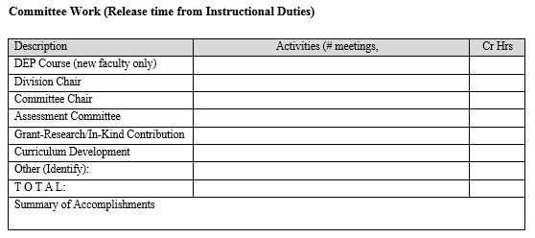
End of Semester Report

Slide 9
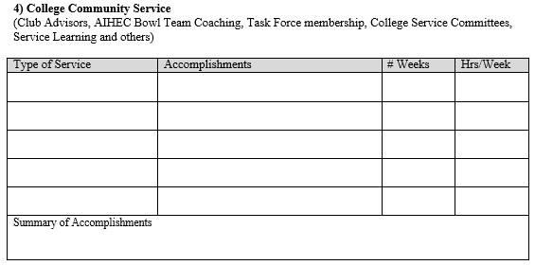
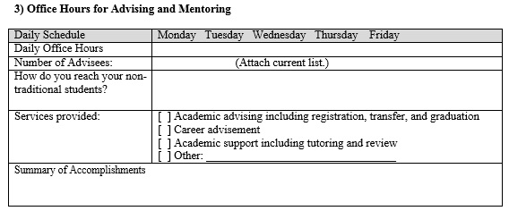
End of Semester Report (cont’d)

Slide 10
Chair Evaluation and Recommendations

Slide 11
Program Review
What are the program's enrollments, retention, and graduation rates for the past three years?
Discuss the program's strengths, distinctiveness, and challenges
What opportunities exist to extend existing strengths?
What are the plans for overcoming the challenges?
Describe improvements that can only be addressed through additional resources

Slide 12
So what?
SNBH MODEL in relation to faculty Evaluation
How do I share the findings with Faculty?
What role do faculty play in Annual planning?
What do I do with all this information?

Slide 13
Questions and Answer

